Slide 1
Task 3
Standard Bank Data Science with Python
27-08-2022

Slide 2
Agenda
Data Science Lifecycle​
Project Overview​
Data
Analysis
Modeling
Model Evaluation
Recommendations

Slide 3
Data Science Lifecycle
A data science lifecycle indicates the iterative steps taken to build, deliver and maintain any data science product. All data science projects are not built the same, so their life cycle varies as well. Still, we can picture a general lifecycle that includes some of the most common data science steps. A general data science lifecycle process includes the use of machine learning algorithms and statistical practices that result in better prediction models. Some of the most common data science steps involved in the entire process are data extraction, preparation, cleansing, modelling, and evaluation etc. The world of data science refers this general process as “Cross Industry Standard Process for Data Mining”.

Slide 4
1. Business Understanding: The complete cycle revolves around the enterprise goal. What will you resolve if you do no longer have a specific problem? It is extraordinarily essential to apprehend the commercial enterprise goal sincerely due to the fact that will be your ultimate aim of the analysis. After desirable perception only we can set the precise aim of evaluation that is in sync with the enterprise objective. You need to understand if the customer desires to minimize savings loss, or if they prefer to predict the rate of a commodity, etc. 2. Data Understanding: After enterprise understanding, the subsequent step is data understanding. This includes a series of all the reachable data. Here you need to intently work with the commercial enterprise group as they are certainly conscious of what information is present, what facts should be used for this commercial enterprise problem, and different information. This step includes describing the data, their structure, their relevance, their records type. Explore the information using graphical plots. Basically, extracting any data that you can get about the information through simply exploring the data. 3. Preparation of Data: Next comes the data preparation stage. This consists of steps like choosing the applicable data, integrating the data by means of merging the data sets, cleaning it, treating the lacking values through either eliminating them or imputing them, treating inaccurate data through eliminating them, additionally test for outliers the use of box plots and cope with them. Constructing new data, derive new elements from present ones. Format the data into the preferred structure, eliminate undesirable columns and features. Data preparation is the most time-consuming but arguably the most essential step in the complete existence cycle. Your model will be as accurate as your data. 4. Exploratory Data Analysis: This step includes getting some concept about the answer and elements affecting it, earlier than constructing the real model. Distribution of data inside distinctive variables of a character is explored graphically the usage of bar-graphs, Relations between distinct aspects are captured via graphical representations like scatter plots and warmth maps. Many data visualization strategies are considerably used to discover each and every characteristic individually and by means of combining them with different features. 5. Data Modeling: Data modeling is the coronary heart of data analysis. A model takes the organized data as input and gives the preferred output. This step consists of selecting the suitable kind of model, whether the problem is a classification problem, or a regression problem or a clustering problem. After deciding on the model family, amongst the number of algorithms amongst that family, we need to cautiously pick out the algorithms to put into effect and enforce them. We need to tune the hyperparameters of every model to obtain the preferred performance. We additionally need to make positive there is the right stability between overall performance and generalizability. We do no longer desire the model to study the data and operate poorly on new data. 6. Model Evaluation: Here the model is evaluated for checking if it is geared up to be deployed. The model is examined on an unseen data, evaluated on a cautiously thought out set of assessment metrics. We additionally need to make positive that the model conforms to reality. If we do not acquire a quality end result in the evaluation, we have to re-iterate the complete modelling procedure until the preferred stage of metrics is achieved. Any data science solution, a machine learning model, simply like a human, must evolve, must be capable to enhance itself with new data, adapt to a new evaluation metric. We can construct more than one model for a certain phenomenon, however, a lot of them may additionally be imperfect. The model assessment helps us select and construct an ideal model. 7. Model Deployment: The model after a rigorous assessment is at the end deployed in the preferred structure and channel. This is the last step in the data science life cycle. Each step in the data science life cycle defined above must be laboured upon carefully. If any step is performed improperly, and hence, have an effect on the subsequent step and the complete effort goes to waste. For example, if data is no longer accumulated properly, you’ll lose records aand you will no longer be constructing an ideal model. If information is not cleaned properly, the model will no longer work. If the model is not evaluated properly, it will fail in the actual world. Right from Business perception to model deployment, every step has to be given appropriate attention, time, and effort.

Slide 5
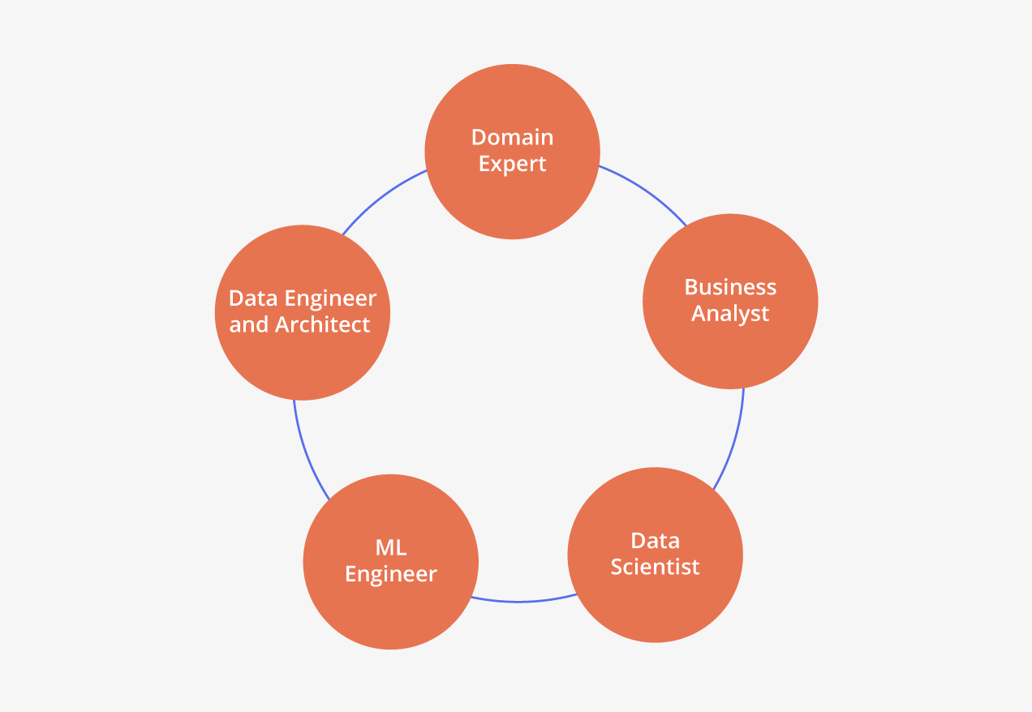
Data Science Life Cycle

Slide 6
Business Objective
Credit / Home Loans - AutoML vs Bespoke ML
Standard Bank is embracing the digital transformation wave and intends to use new and exciting technologies to give their customers a complete set of services from the convenience of their mobile devices. As Africa’s biggest lender by assets, the bank aims to improve the current process in which potential borrowers apply for a home loan. The current process involves loan officers having to manually process home loan applications. This process takes 2 to 3 days to process upon which the applicant will receive communication on whether or not they have been granted the loan for the requested amount. To improve the process Standard Bank wants to make use of machine learning to assess the credit worthiness of an applicant by implementing a model that will predict if the potential borrower will default on his/her loan or not, and do this such that the applicant receives a response immediately after completing their application

Slide 7
Business Problem
The Home Loans Department manager wants to know the following:
An overview of the data. (HINT: Provide the number of records, fields and their data types. Do for both).
What data quality issues exist in both train and test? (HINT: Comment any missing values and duplicates)
How do the the loan statuses compare? i.e. what is the distrubition of each?
How do women and men compare when it comes to defaulting on loans in the historical dataset?
How many of the loan applicants have dependents based on the historical dataset?
How do the incomes of those who are employed compare to those who are self employed based on the historical dataset?
Are applicants with a credit history more likely to default than those who do not have one?
Is there a correlation between the applicant's income and the loan amount they applied for?

Slide 8
Hypothesis
follow the data science lifecycle to fulfill the objective. The data science lifecycle includes:
Business Understanding
Data Understanding
Data Preparation
Modelling
Evaluation
Deployment.

Slide 9
Data
Data 1 (train.csv)

Slide 10
Data
Data 2 (test.csv)

Slide 11
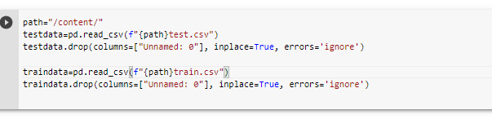
We import test.csv,train.csv in notebook

Slide 12
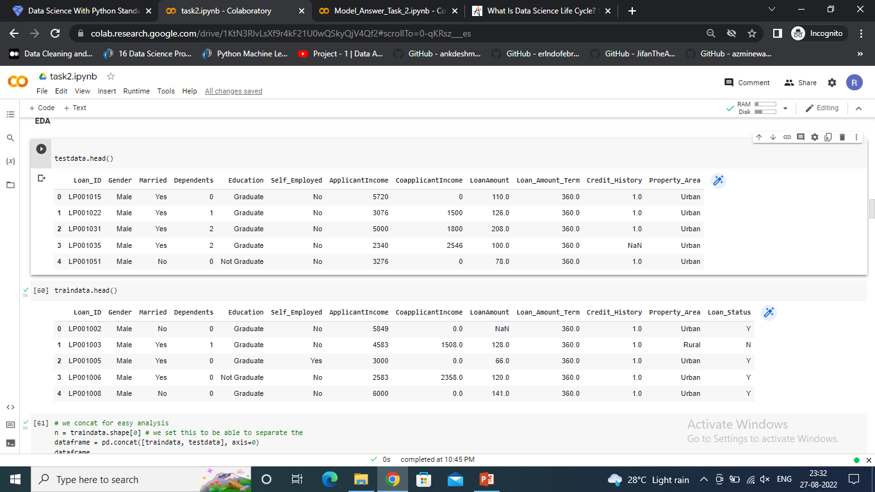
We have named train data as traindata

Slide 13

We have named test data as testdata

Slide 14
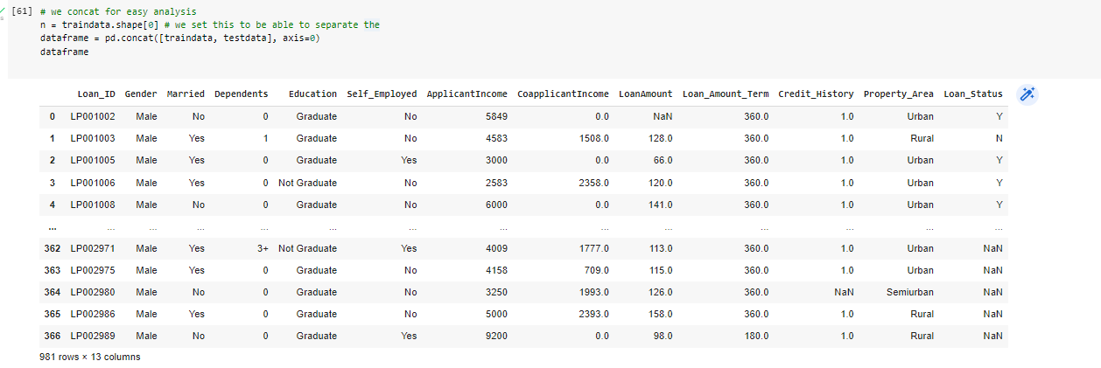
Analysis
Analysis
We create a dataframe and merge data of the two files

Slide 15
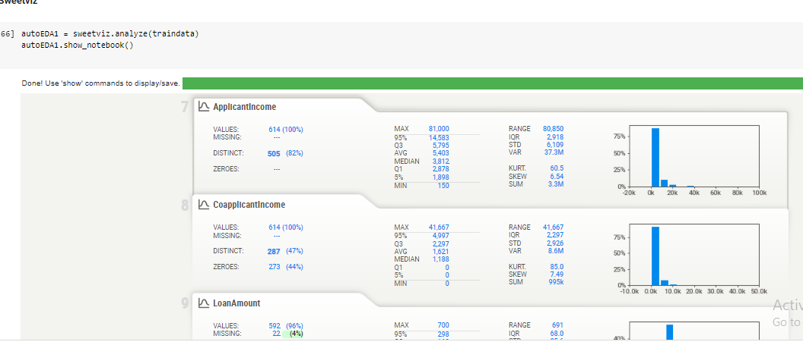
Auto EDA traindata

Slide 16
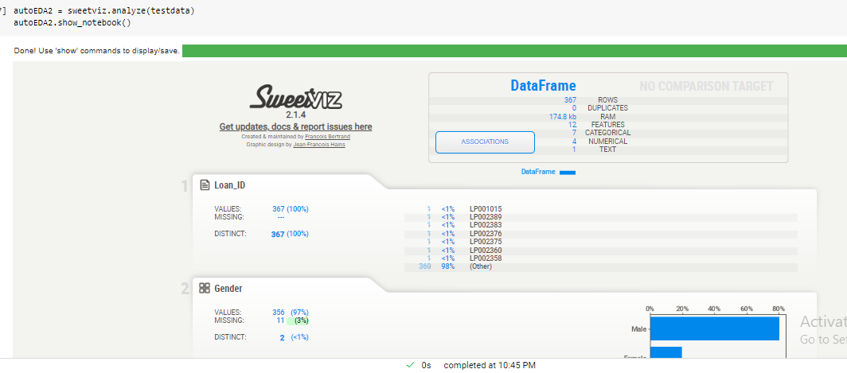
Auto EDA testdata

Slide 17
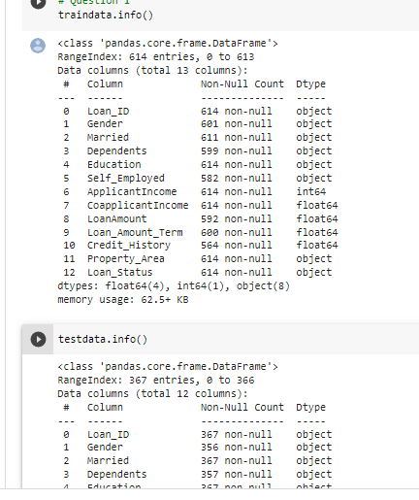
Solution
Solution file can be found at this link https://colab.research.google.com/drive/1KtN3RlvLsXf9r4kF21U0wQSkyQjV4Qf2?usp=sharing

